Slide 1






Foundations of
Quantum Information Science (QIS 101)
Dave Biersach
Brookhaven National Laboratory
dbiersach@bnl.gov
Session 05
Algorithmic
Efficiency

Slide 2
Session 05 – Goals
Appreciate how to encode and decode objects as numbers
Learn about Python Sequences, including Lists and Arrays
Correlate index numbers and addressable elements
Use the enumerate() class to loop through Lists
Represent anonymous variables with a single underscore
Measure (instrument) code performance using Python's built-in high-precision timers
Review run-time complexity and big-O notation
Leverage handy algorithms already implemented in Numpy

Slide 3
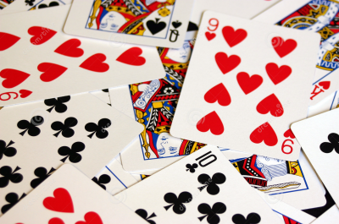
Encoding (Representation)
Cards in a deck are numbered 0 – 51
Card Suit |  |  | Card Rank
0 | Clubs |  | 0 | Deuce
1 | Diamonds |  | 1 | Three
2 | Hearts |  | 2 | Four
3 | Spades |  | 3 | Five
 |  |  | 4 | Six
 |  |  | 5 | Seven
 |  |  | 6 | Eight
 |  |  | 7 | Nine
 |  |  | 8 | Ten
 |  |  | 9 | Jack
 |  |  | 10 | Queen
 |  |  | 11 | King
 |  |  | 12 | Ace
How can we convert to & from a card # and a specific suit and rank?

Slide 4
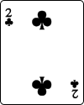
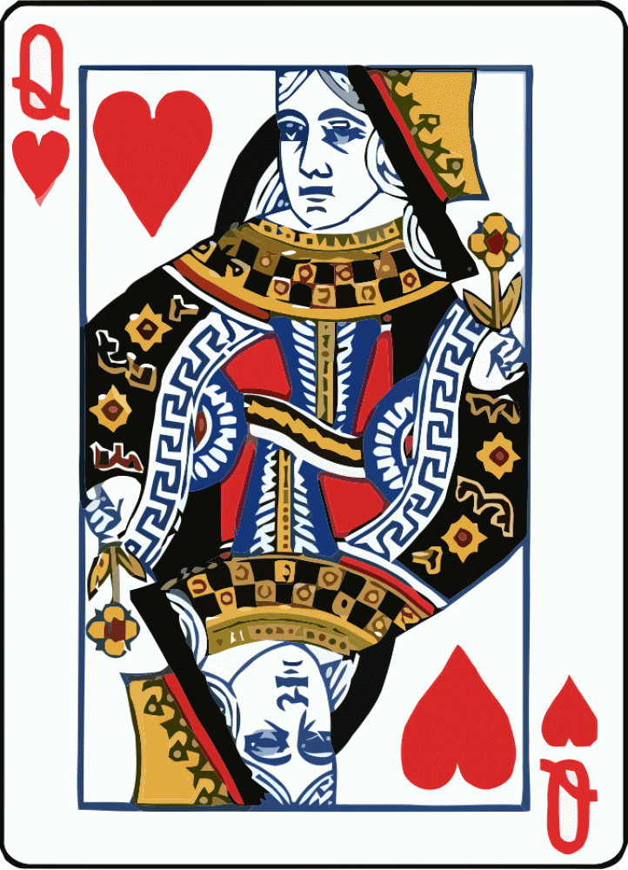
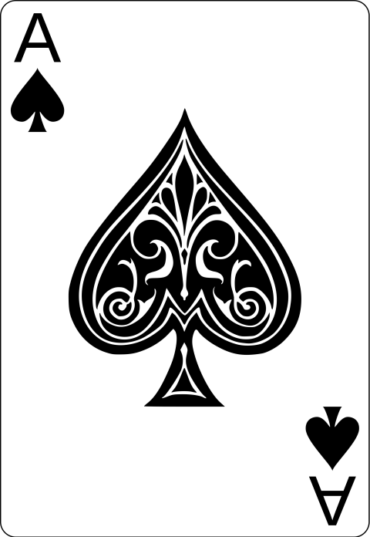
Encoding (Representation)
Cards in a deck are numbered 0 – 51
Card # = Suit * 13 + Rank
Card Suit |  |  | Card Rank
0 | Clubs |  | 0 | Deuce
1 | Diamonds |  | 1 | Three
2 | Hearts |  | 2 | Four
3 | Spades |  | 3 | Five
 |  |  | 4 | Six
 |  |  | 5 | Seven
 |  |  | 6 | Eight
 |  |  | 7 | Nine
 |  |  | 8 | Ten
 |  |  | 9 | Jack
 |  |  | 10 | Queen
 |  |  | 11 | King
 |  |  | 12 | Ace
Suit = 0
Rank = 0
0 * 13 + 0 = 0
Suit = 2
Rank = 10
2 * 13 + 10 = 36
Suit = 3
Rank = 12
3 * 13 + 12 = 51

Slide 5
Decoding (Representation)
Cards in a deck are numbered 0 – 51
Suit = (Card #) // 13
Rank = (Card #) % 13
Card Suit |  |  | Card Rank
0 | Clubs |  | 0 | Deuce
1 | Diamonds |  | 1 | Three
2 | Hearts |  | 2 | Four
3 | Spades |  | 3 | Five
 |  |  | 4 | Six
 |  |  | 5 | Seven
 |  |  | 6 | Eight
 |  |  | 7 | Nine
 |  |  | 8 | Ten
 |  |  | 9 | Jack
 |  |  | 10 | Queen
 |  |  | 11 | King
 |  |  | 12 | Ace
// returns the integer quotient
39 // 7 = 5
% is the modulus (remainder)
39 % 7 = 4

Slide 6
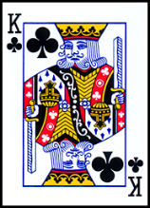
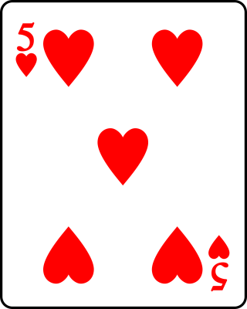
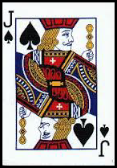
Decoding (Representation)
Cards in a deck are numbered 0 – 51
Suit = (Card #) // 13
Rank = (Card #) % 13
Card Suit |  |  | Card Rank
0 | Clubs |  | 0 | Deuce
1 | Diamonds |  | 1 | Three
2 | Hearts |  | 2 | Four
3 | Spades |  | 3 | Five
 |  |  | 4 | Six
 |  |  | 5 | Seven
 |  |  | 6 | Eight
 |  |  | 7 | Nine
 |  |  | 8 | Ten
 |  |  | 9 | Jack
 |  |  | 10 | Queen
 |  |  | 11 | King
 |  |  | 12 | Ace
Card # = 11
Suit = 11 // 13 = 0
Rank = 11 % 13 = 11
Card # = 29
Suit = 29 // 13 = 2
Rank = 29 % 13 = 3
Card # = 48
Suit = 48 // 13 = 3
Rank = 48 % 13 = 9

Slide 7
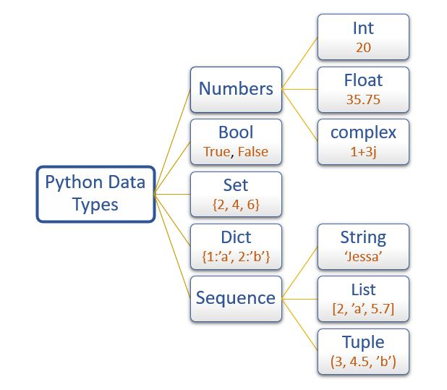
Python Built-In Data Types

Slide 8
Python Lists
A list is a set of elements that can have varying types
Individual elements in a list are accessed by using their index number within square [] brackets
Every element has a unique index number
No two elements share the exact same index number
The first element has an index = 0
The function len() returns the length of a list, which is the number of element in list
The last addressable element in a list is [len() – 1] – why?

Slide 9
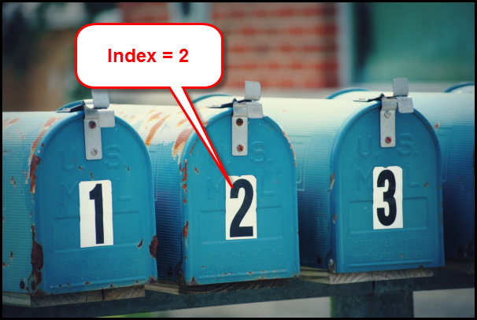

Index Number versus Element Value
list_name[2]

Slide 10
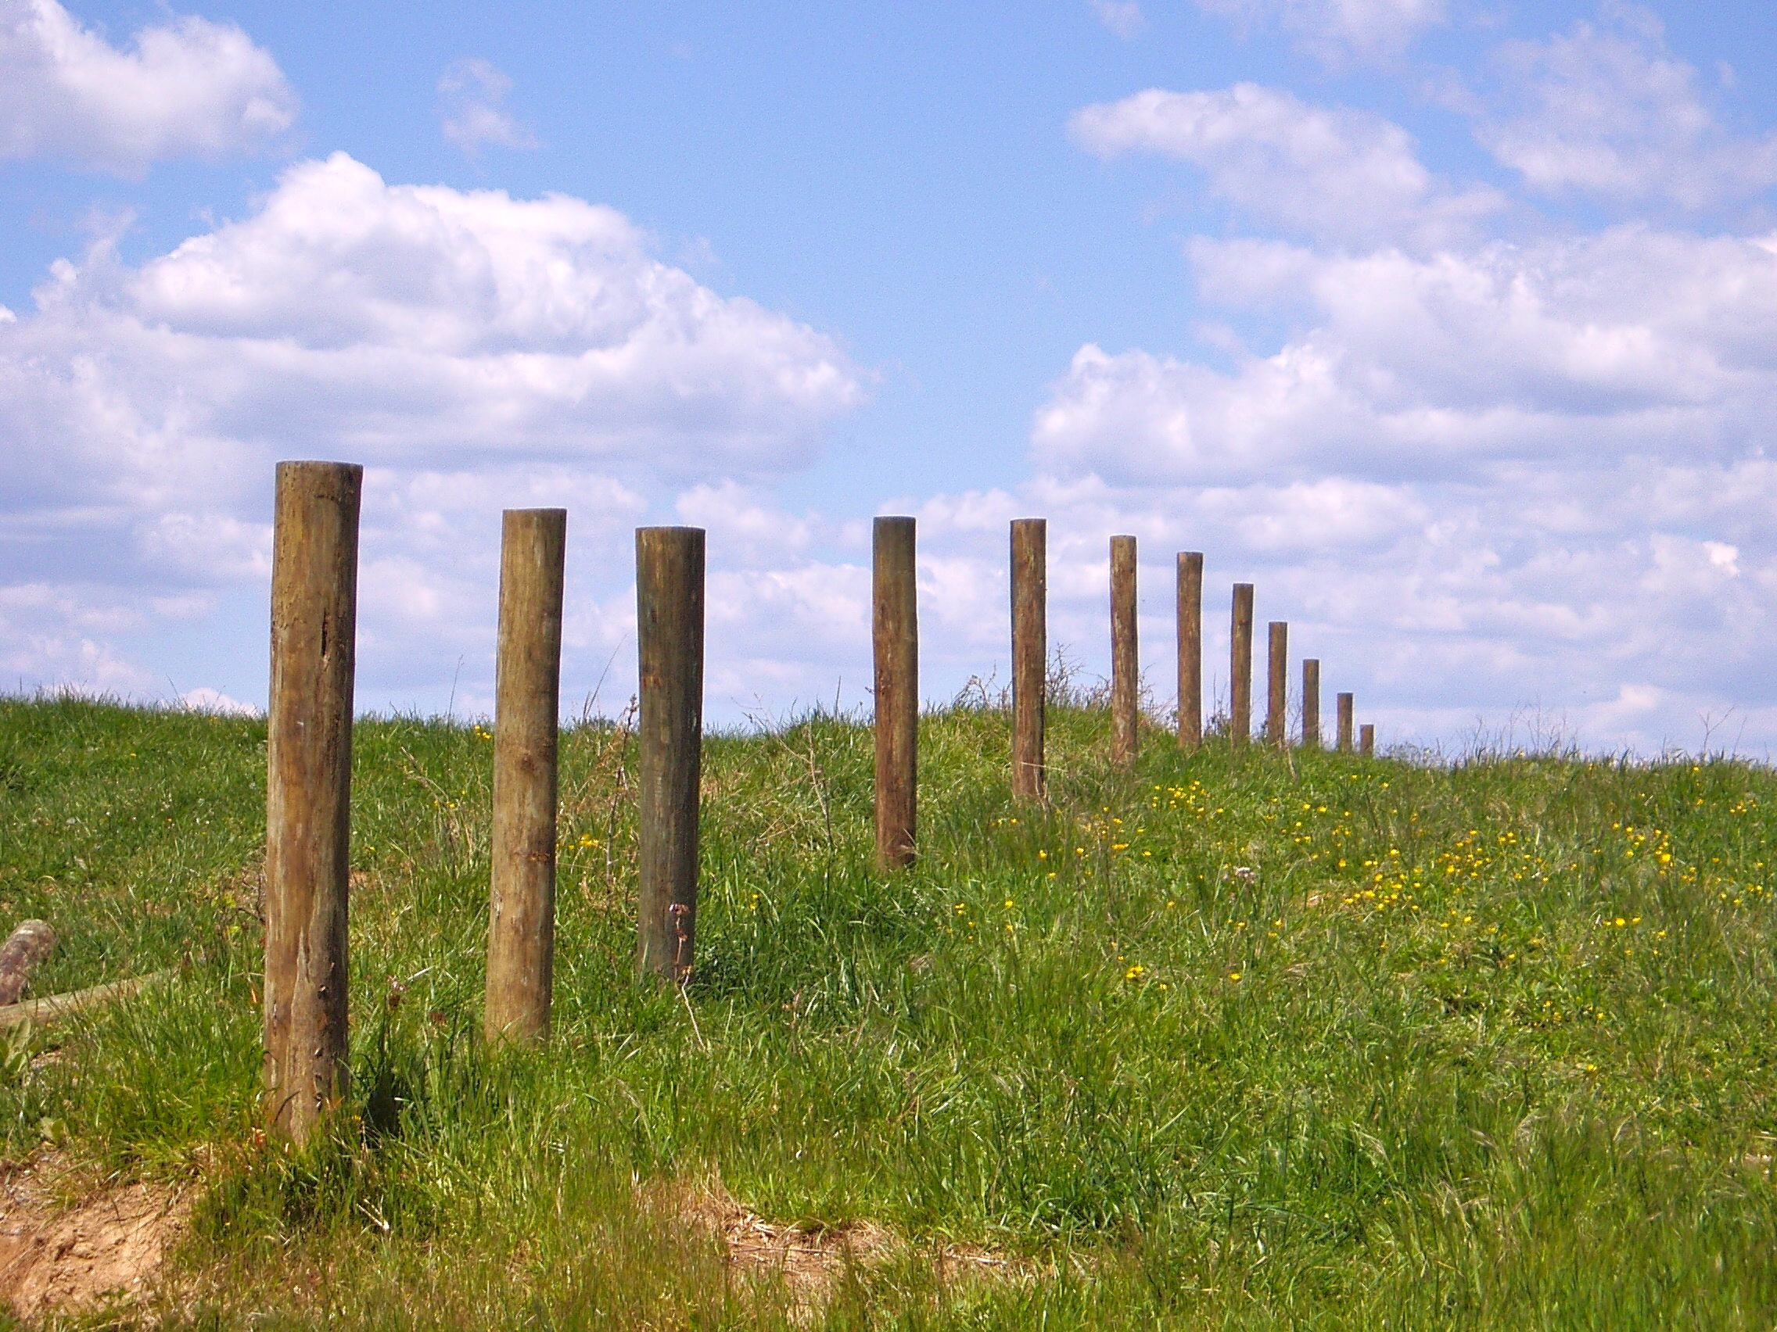
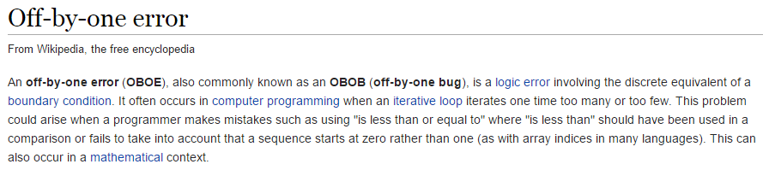
The Bane of All Programmers
This problem is why we all agree to always use ZERO as the first index value in an array.
Remember…
ZERO is a THING!
A farmer needs a fence 100m long
He wants 2m between each fence post
How many posts does he need?

Slide 11
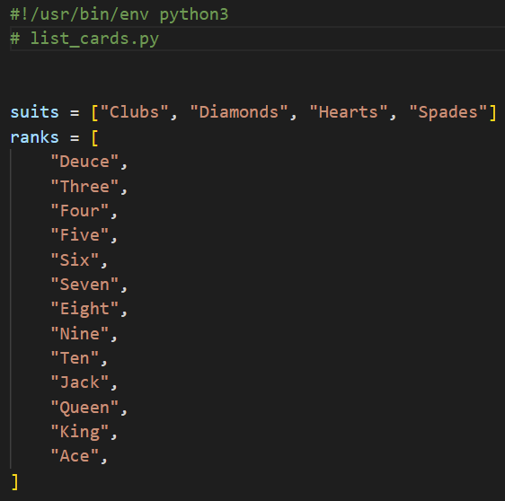
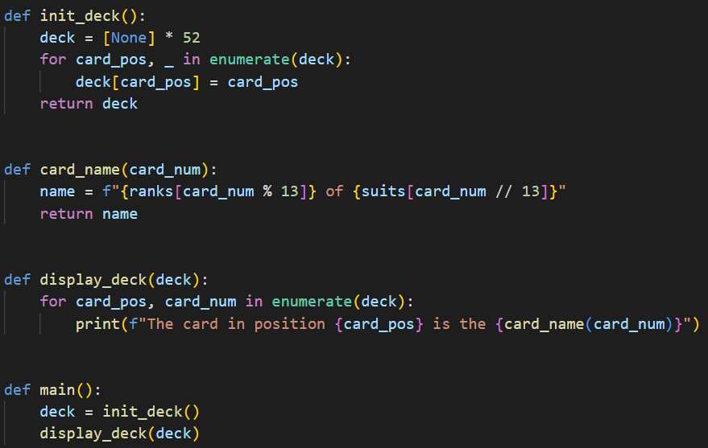
Open list_cards.py
①
②
④
⑤
⑥
⑦
⑧
⑩
⑨
③

Slide 12
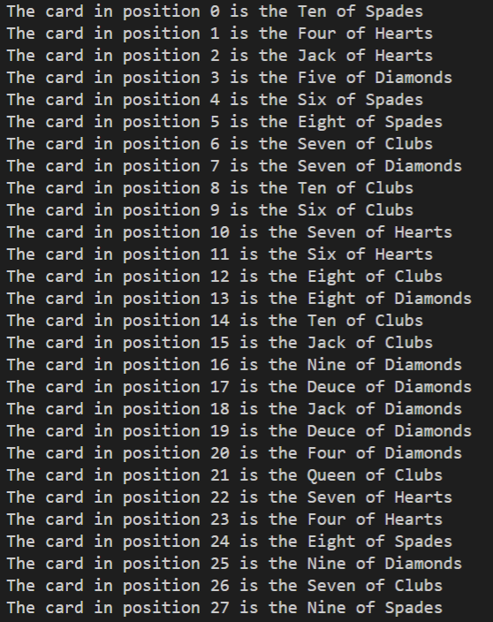
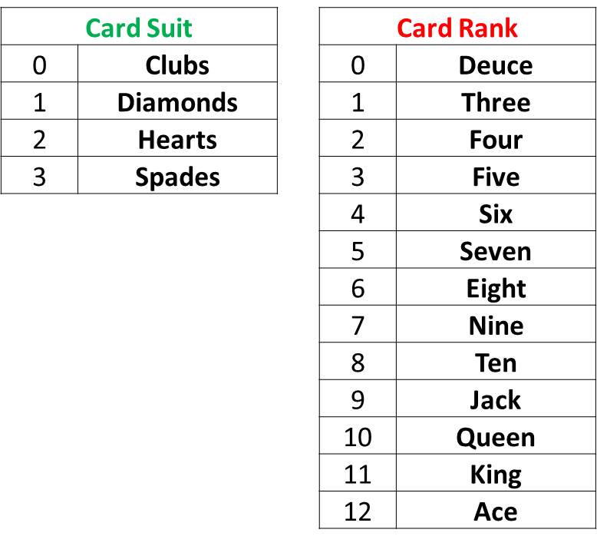
Run list_cards.py

Slide 13
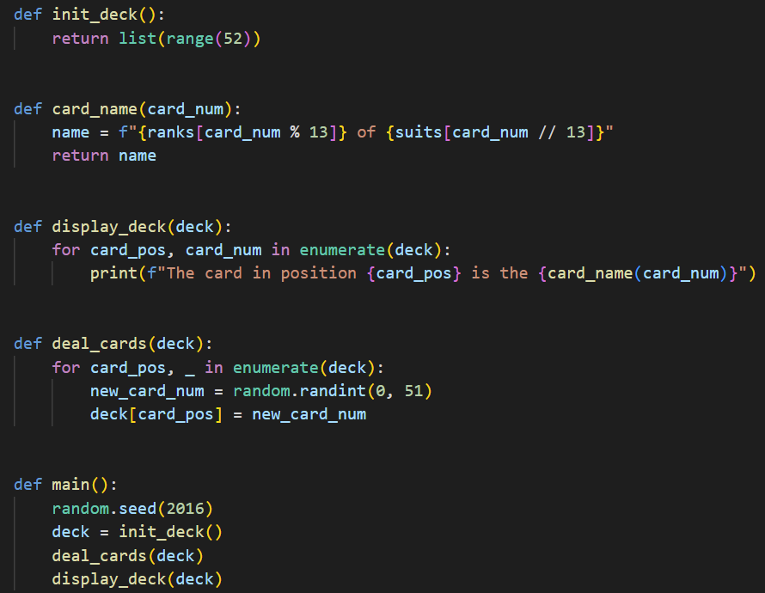
Open dealer_bogus.py
③
⑩
⑤
⑥
⑦
⑧
①
②
④
⑨

Slide 14
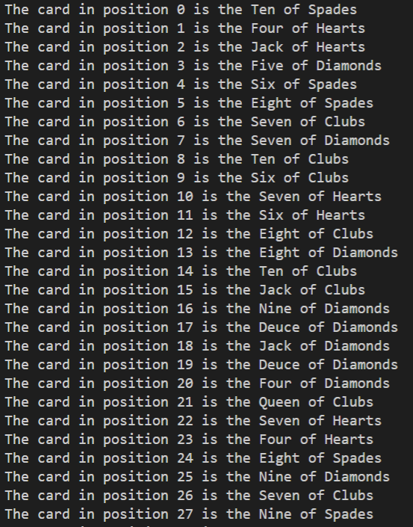
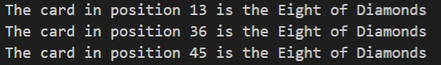
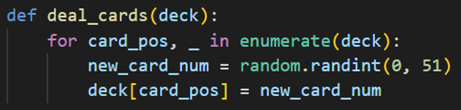
Run dealer_bogus.py

Slide 15
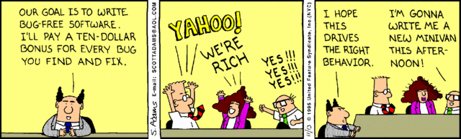
Random… but no repeats?
How can we get a set of random numbers where no number is repeated until all numbers are picked at least once?
Can we flag that a particular card # has already been dealt, and therefore not deal that card again?

Slide 16
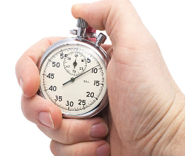
Instrumenting Your Code
Instrumenting code is the process of taking accurate timings of the runtime performance of key algorithms within the program
Python provides a time object that can measure the current CPU time of a running process to the nearest millisecond (1/1000th of a second) which is sufficient in most situations
We bracket the code under analysis by measuring the clock immediately before the start and again after the end of the algorithm to calculate the elapsed time
Careful tracking of code timings will provide objective empirical evidence if changes to algorithms and/or data structures are indeed making the program more efficient

Slide 17
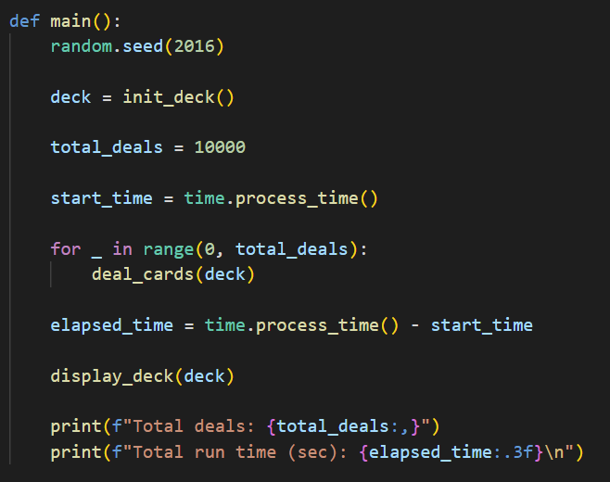
Open dealer_slow.py
Write code to correctly deal 10,000 decks
①
②
③
④
⑤

Slide 18
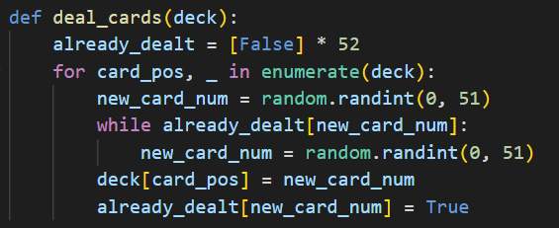
View dealer_slow.py
We need a helper list to store a True or False flag to record if a random “trial” card # has already been dealt
Keeping picking trial card #s until a card # is found that has not yet been dealt. Then update the helper list to record the fact that card # has been dealt so it cannot be picked again
①
②
③
④
⑤
⑥
⑦
⑧

Slide 19
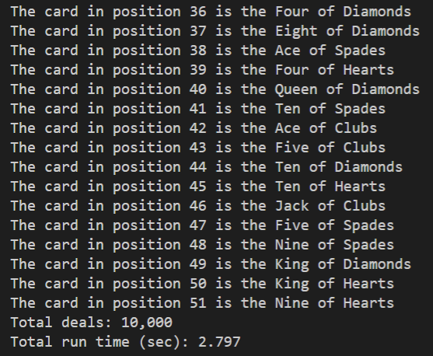
Run dealer_slow.py
No repeated cards!

Slide 20
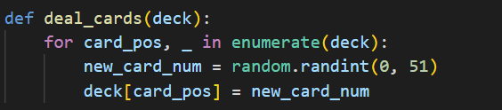
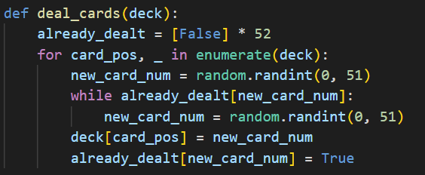
Correct but inefficient…
dealer_bogus.py
dealer_slow.py

Slide 21
A Faster Card Dealer
There is an inherent inefficiency in the naïve algorithm employed in the current deal_cards() function
It takes longer and longer, as more cards are dealt, to randomly pick (find) a card that has not yet been dealt
We need to discover an algorithm that, while ensuring every card is dealt only once, doesn't lose time at the end of the deal searching for that one remaining card that has not yet been dealt
The improved algorithm doesn’t need an already_dealt helper list and it was discovered by a 7th grader!

Slide 22
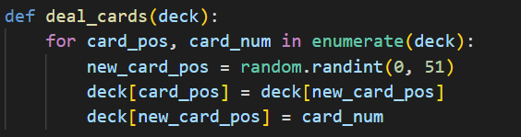
Open dealer_fast.py
Consider the revised deal_cards() function:
What is going on in this function that ensures no duplicate cards are dealt and doesn't waste time trying to find the cards at the end which have not yet been dealt?

Slide 23
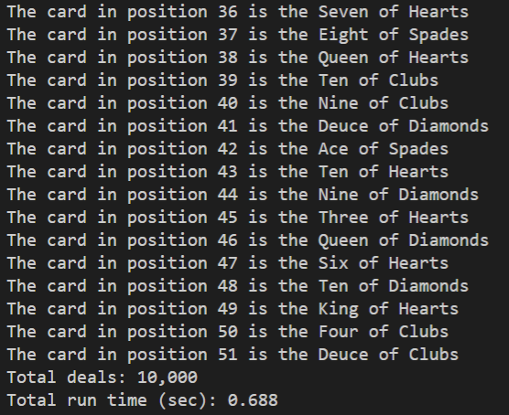
Run dealer_fast.py
No repeated cards!

Slide 24

Slow vs. Fast Card Dealer
dealer_slow.py
dealer_fast.py
①
②
Fewer lines of code
No helper list needed
4X faster
Discovered by a 7th grader

Slide 25
Computing is a New Science
The best algorithms are the ones that leave you scratching your head thinking “…that was so obvious – why didn’t I think of that?”
They are often the shortest algorithms in terms of source code length (but not always)
They are also normally the fastest algorithms to execute
For many algorithms, we have yet to discover an optimal approach!
Even students taking an initial computer science course can get a flash of inspiration and see something in a new way
You can't appreciate the power of Quantum Algorithms if you don't understand the challenges facing classical algorithmic efficiency

Slide 26
Algorithmic Efficiency
Scientific computing often involves analyzing large data sets or running large-scale simulations
It is very important to have code that runs as fast as possible while returning the correct results
We measure algorithm efficiency by estimating the impact on the total run time as the size of the input data increases
We are only interested in the principal (highest exponent) term which describes the overall “order” of the algorithm, and are not trying to estimate the exact run time
The order of an algorithm is expressed in “Big O” notation
The optimal algorithms have the smallest possible order

Slide 27
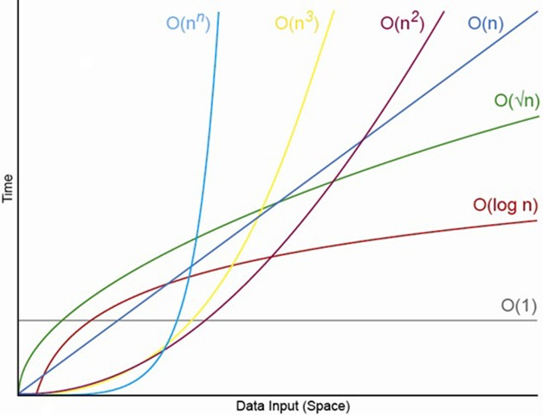
Algorithmic Efficiency
n is the # of items you must process

Slide 28
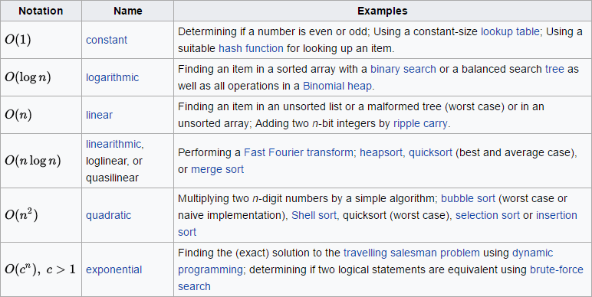
Algorithmic Efficiency

Slide 29
Prime Racer
Write a program to generate a list of 10,000 random integers (all between 100,000 and 1,000,000 inclusive)
Count the number of prime numbers within that list
Use the time.process_time() function to instrument your code and measure the total run time in seconds
As we make changes to the algorithm, we compare the total run time between versions to accumulate hard evidence that our changes are indeed making the code run faster
As we further optimize the program, we must continue to ensure it is emitting correct and consistent output

Slide 30
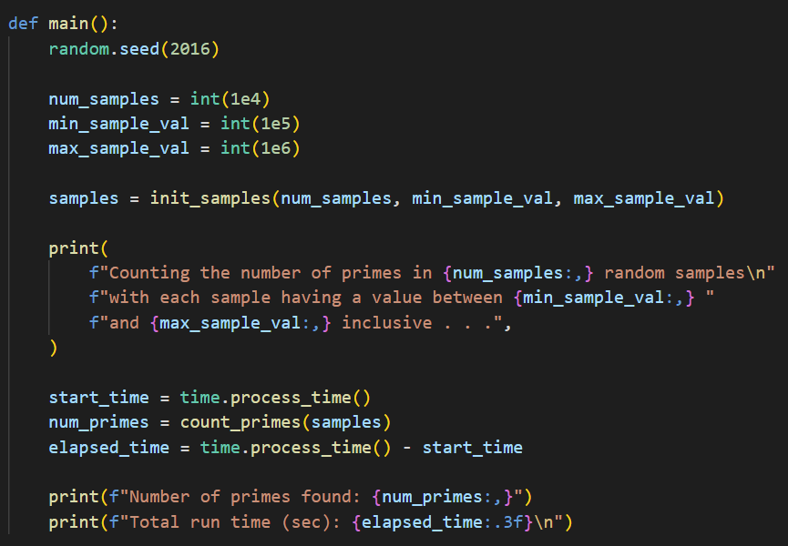
Open prime_racer1.py
①
②
③
④
⑤
⑥
⑦
⑧
⑨
⑩

Slide 31
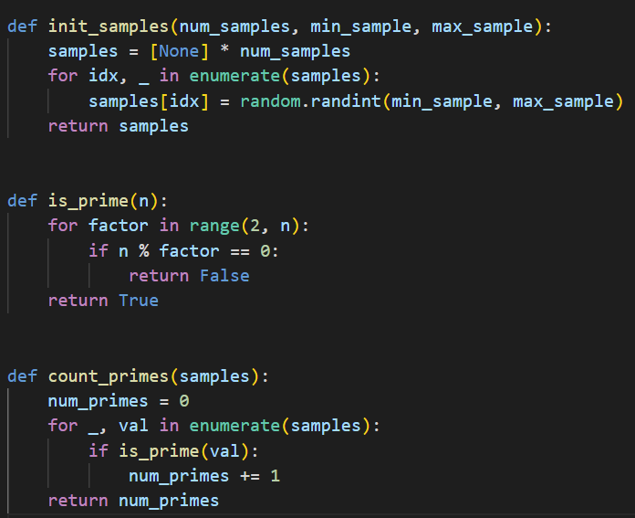
View prime_racer1.py
①
②
③
④
⑧
⑨
⑤
⑥
⑦
⑩

Slide 32
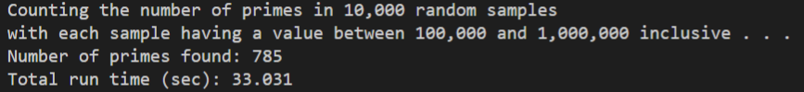
Run prime_racer1.py
①
②

Slide 33
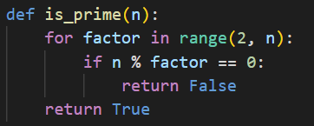
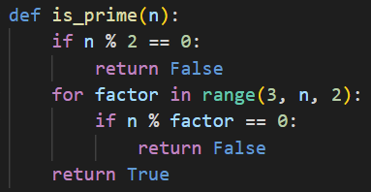
Open prime_racer2.py
prime_racer1.py
prime_racer2.py
①
②
If a number is even, it is not prime
All other factors must be odd, so the step size in the range() function can be 2 to skip over testing all other even potential factors

Slide 34
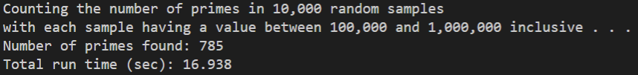
Run prime_racer2.py
①
②

Slide 35
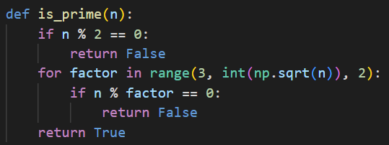
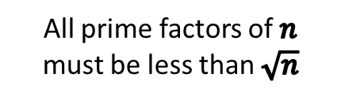
Open prime_racer3.py
prime_racer2.py
prime_racer3.py
All prime factors of $n$ must be less than $\sqrt{n}$

Slide 36
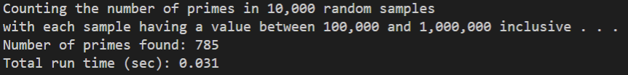
Run prime_racer3.py
①
②

Slide 37
Measurable Systematic Improvement
①
②
③
We have made the code run 100X faster!

Slide 38
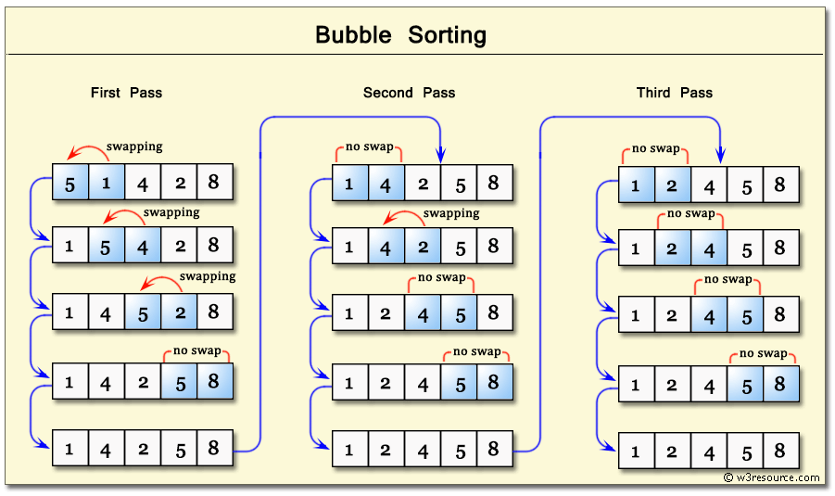
Bubble Sort

Slide 39
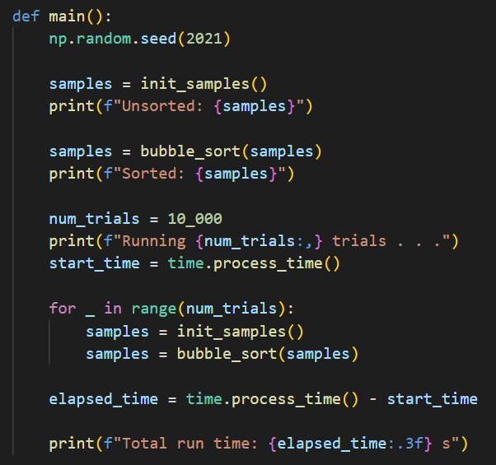
Open bubble_sort.py
①
②
③
④
⑤
⑥
⑦
⑧
⑨
⑩

Slide 40
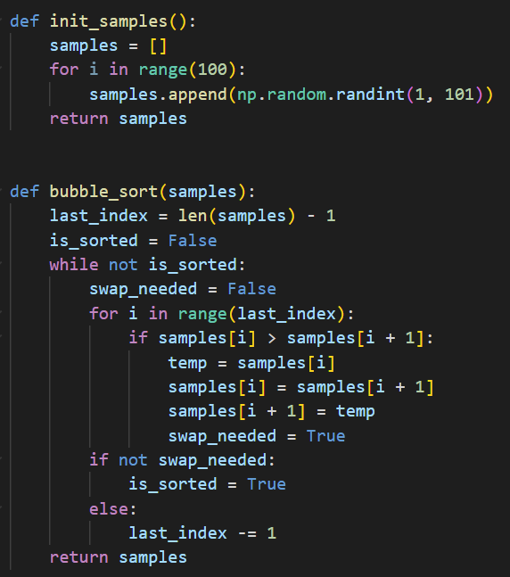
View bubble_sort.py
①
②
③
④
⑤

Slide 41
View bubble_sort.py
①
②
③
④
⑤
⑥
⑦
⑧
⑨
⑩

Slide 42
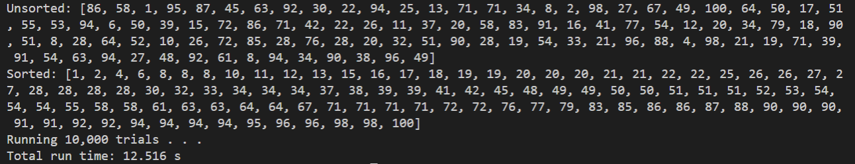
Run bubble_sort.py
①

Slide 43
The Bubble Sort Algorithm
The Bubble Sort is not very efficient because it can “move” only one element only one slot during one pass
The code spends a lot of time scanning through the array reconfirming that no swaps are needed between adjacent elements, just the same as it likely had confirmed that very fact on the previous pass through the array
It wastes time constantly rediscovering that two elements are already in the right order – this is the culprit
Wouldn’t it be better if we could move a higher test score farther to the end of the array in one big jump, rather than only a single slot each pass?
And can we stop wasting time scanning through groups of elements we have already proven to be in order?

Slide 44
The Quicksort Algorithm
Invented by Tony Hoare in 1959, Quicksort is an efficient sorting algorithm that uses a divide & conquer strategy to overcome the problems of Bubble Sort
On each pass, a portion of the array is split according to a pivot value – those elements with a value <= the pivot are swapped with those elements with a value > the pivot
This act of partitioning separates the current portion of the list into a “left” portion having smaller values than the pivot, and a “right” portion having larger values than the pivot
The left and right portions are then sorted (conquered) independently, and each portion is further split (divided) into smaller and smaller sized sub-portions, until the whole list is eventually sorted

Slide 45

The Quicksort Algorithm

Slide 46
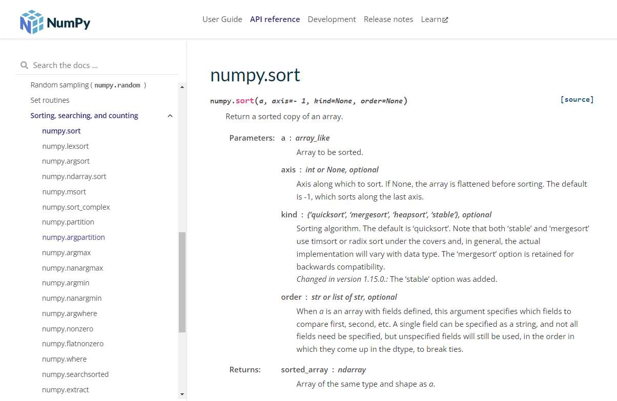
Numpy sort()

Slide 47
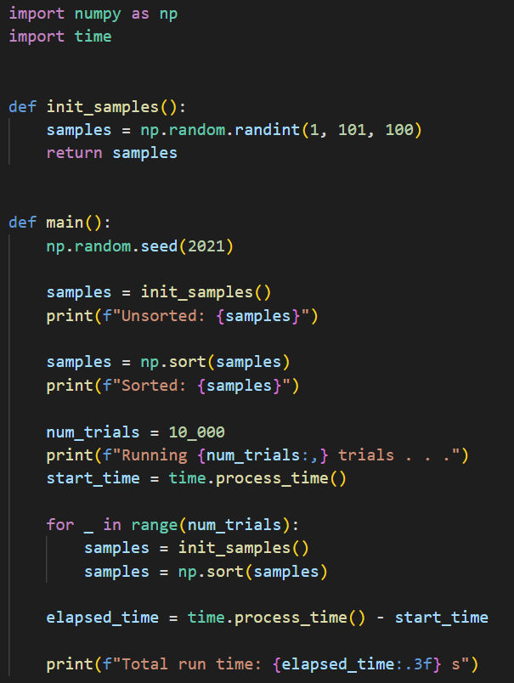
Open quicksort.py
①
④
②
③
⑤
Don't reinvent the wheel – leverage existing Python packages!
⑥
⑦
⑧
⑨
⑩

Slide 48
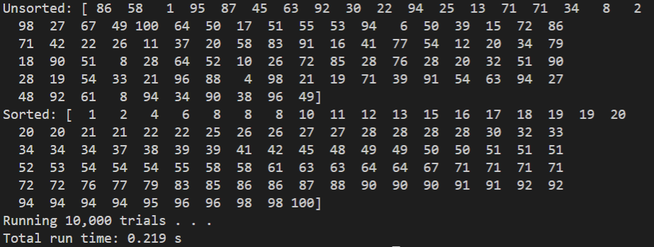
Run quicksort.py
①
Quicksort runs 5,700% faster than Bubble Sort!
②

Slide 49
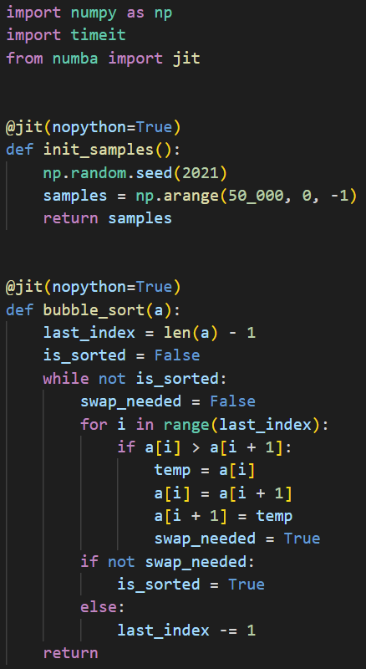
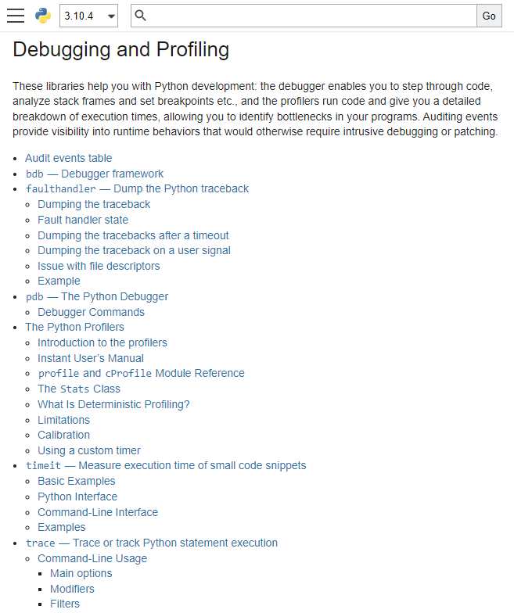
Open sort_race.py
①
②
③
④
⑤

Slide 50
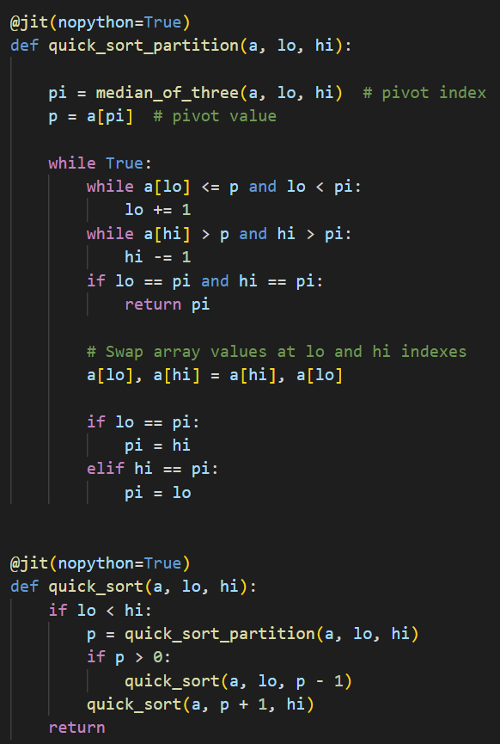
View sort_race.py
④
⑤
⑥
⑦
⑧
①
②
③
⑨
⑩

Slide 51
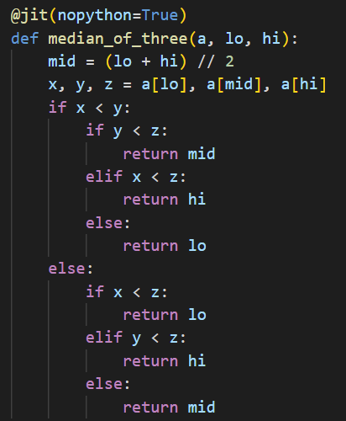
View sort_race.py
①
②
③
④

Slide 52

View sort_race.py
②
⑤
①
③
④
⑥

Slide 53





Run sort_race.py
Sometimes extra code complexity is worth it!
①
②
Bubble Sort
Quicksort

Slide 54
Now you know…
One true art of computer science is the ability to concisely represent things as just a number
Encoding needs to be unambiguous to support proper decoding
Decoding multiple things from a single number often requires the use of the modulus % operator
Lists, Strings, and Tuples are Python sequences that can be iterated
Sequences have elements that can be accessed by their unique index number inside square [] brackets

Slide 55
Now you know…
The len() function returns the number of elements in the sequence
Sequence indexes are zero based - the first element is at index 0 - for example: mylist[0]
The last addressable element in a sequence is at len() - 1
Remember this phrase: "zero is a thing…zero counts"
The enumerate() class returns an iterable sequence of indexes and their corresponding element values
A single underscore _ can be used as a placeholder for a "don't care" (insignificant, anonymous, temporary) variable

Slide 56
Now you know…
The time object has a process_time() function that returns the current CPU time
We can instrument (time) code by measuring the elapsed time between when it starts and ends
The timeit module makes it almost trivial to find the average runtime across several runs of your code
Look at packages like Numpy to see if they already have implemented an algorithm that you need
Quantum algorithms may offer dramatic speedup for classical algorithms that have an exponential runtime complexity

Slide 57
Now you know…
The swap pattern comes up very often in programming – Python makes this easy using tuple packing and unpacking
Bubble Sort is easy to understand but very inefficient
Quicksort is more complex to understand but is orders of magnitude faster than Bubble Sort
New algorithms are still being discovered every day - what new algorithm will you invent to improve the world?

Slide 58
Task 05-01
Write a Python program called hamming_weight.py that implements a function to calculate the population count of a given integer
Calculate and display the Hamming Weight of 95,601
Compare the result of your function to a similar capability already available in Python
Upload your solution to the BNL QIS101 SharePoint site

Slide 59


Task 05-02
Create a Python program called prime_racer4.py based upon prime_racer3.py that further decreases its runtime
Various hints:
Avoid trial dividing every odd number from $3≤ \sqrt{sample}$
Instead, only need to test if 𝑠𝑎𝑚𝑝𝑙𝑒 % 𝑝==0 𝑤ℎ𝑒𝑟𝑒 𝒑 ∈ 𝒑𝒓𝒊𝒎𝒆𝒔
Precompute an array of primes $<\sqrt{1,000,000}$
Trial divide every sample using only this array of primes
Upload your solution to the BNL QIS101 SharePoint site
prime_racer3.py
prime_racer4.py (DaveB)

Slide 60
Task 05-03
Complete the existing program called connect_four.py to determine and display the name of the winner (Player 1 or Player 2) of a given Connect Four board
The current code contains three lists (board1, board2, board3), with each 2D list encoding a board configuration
0 = The space is empty (neither player has a checker in that space)
1 = The space is occupied by a checker owned by Player 1
2 = The space is occupied by a checker owned by Player 2
Follow the standard rules for Connect Four to determine the winner (if there is a winner for that board)
Upload your solution to the BNL QIS101 SharePoint site

Slide 61



Task 05-03

